Slide 1
Object Detection (part 1)
CS5330, Huaizu Jiang
Fall 2021, Northeastern University

Slide 2

Announcement
Guest lecture by Dr. RoyChowdhury on Monday, Nov 29
Topic: Learning from unlabeled data
The speaker is vaccinated. We will follow the university’s protocol to submit a COVID test within 3 days before the guest lecture
No recording, slides (checking with the speaker)
The speaker is happy to chat after the class
Dr. Aruni RoyChowdhury
Research Scientist
Amazon AWS AI

Slide 3
Recap

Slide 4
From AlexNet, VGG, to ResNet
Softmax
FC 1000
Softmax
Pool
FC 1000
3x3 conv, 512
Softmax
FC 4096
3x3 conv, 512
FC 1000
FC 4096
3x3 conv, 512
FC 4096
Pool
3x3 conv, 512
FC 4096
3x3 conv, 512
relu
3x3 conv, 512
Pool
3x3 conv, 512
F(x) + x
3x3 conv, 512, /2
3x3 conv, 512
3x3 conv, 512
...
3x3 conv, 512
3x3 conv, 512
3x3 conv, 512
Pool
Pool
3x3 conv, 512
3x3 conv
3x3 conv, 128
Softmax
3x3 conv, 512
3x3 conv, 512
F(x)
3x3 conv, 128
FC 1000
3x3 conv, 512
3x3 conv, 512
relu
3x3 conv, 128
FC 4096
3x3 conv, 512
3x3 conv, 512
3x3 conv, 128
FC 4096
Pool
Pool
3x3 conv
3x3 conv, 128
Pool
3x3 conv, 256
3x3 conv, 256
3x3 conv, 128, / 2
3x3 conv, 256
3x3 conv, 256
3x3 conv, 256
3x3 conv, 64
3x3 conv, 384
Pool
Pool
3x3 conv, 64
Pool
3x3 conv, 128
3x3 conv, 128
X
3x3 conv, 64
3x3 conv, 384
3x3 conv, 128
3x3 conv, 128
3x3 conv, 64
Pool
Pool
Pool
Residual block
3x3 conv, 64
5x5 conv, 256
3x3 conv, 64
3x3 conv, 64
3x3 conv, 64
11x11 conv, 96
3x3 conv, 64
3x3 conv, 64
Input
Input
Input
Pool
AlexNet
VGG16
VGG19
7x7 conv, 64, / 2
Input
ResNet
Simonyan and Zissermann, “Very Deep Convolutional Networks for Large-Scale Image Recognition”, ICLR 2015
Slide credit: D Fouhey & J Johnson

Slide 5
AlexNet vs VGG-16: Much Bigger!
AlexNet total: 1.9 MB
VGG-16 total: 48.6 MB (25x)
AlexNet total: 61M
VGG-16 total: 138M (2.3x)
AlexNet total: 0.7 GFLOP
VGG-16 total: 13.6 GFLOP (19.4x)
Slide credit: D Fouhey & J Johnson

Slide 6
ImageNet Classification Challenge
152 Layer
152 Layer
152 Layer
19 Layer
22 Layer
8 Layer
8 Layer
Shallow
Lin et al
Sanchez & Perronnin
Krizhevsky et al (AlexNet)
Zeiler & Fergus
Simonyan & Zisserman (VGG)
Szegedy et al (GoogLeNet)
He et al (ResNet)
Shao et al
Hu et al
(SENet)
Slide credit: D Fouhey & J Johnson

Slide 7
ImageNet Classification Challenge
152 Layer
152 Layer
152 Layer
19 Layer
22 Layer
8 Layer
8 Layer
Shallow
Lin et al
Sanchez & Perronnin
Krizhevsky et al (AlexNet)
Zeiler & Fergus
Simonyan & Zisserman (VGG)
Szegedy et al (GoogLeNet)
He et al (ResNet)
Shao et al
Hu et al
(SENet)
Russakovsky et al
Slide credit: D Fouhey & J Johnson

Slide 8
Recap: Training CNNs
Download big datasets
Design CNN architecture
Initialize Weights
For t = 1 to T:
Form minibatch
Compute loss + gradient
Update Weights
Apply trained model to task
Transfer Learning
Xavier / MSRA Init
Regularization + Data Augmentation
Slide credit: D Fouhey & J Johnson

Slide 9
Training Convolutional Networks
Download big datasets
Design CNN architecture
Initialize Weights
For t = 1 to T:
Form minibatch
Compute loss + gradient
Update Weights
Apply trained model to task
If the model is big, won’t we overfit?
Slide credit: D Fouhey & J Johnson

Slide 10
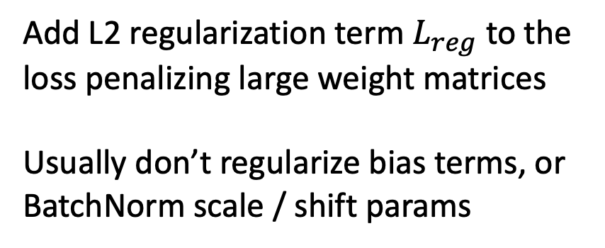
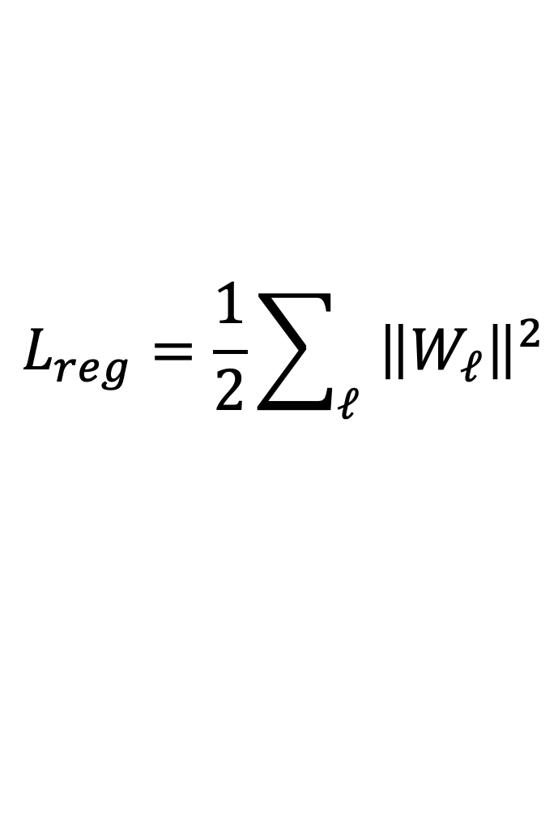
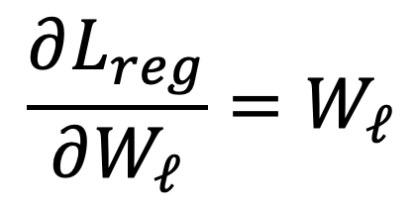
Regularizing CNNs: Weight Decay
$$L_{reg}=\frac{1}{2}\sum_{ℓ}{{\left\|W_{ℓ}\right\|}^{2}}$$
$$\frac{∂L_{reg}}{∂W_{ℓ}}=W_{ℓ}$$
Add L2 regularization term $L_{reg}$ to the loss penalizing large weight matrices
Usually don’t regularize bias terms, or BatchNorm scale / shift params
*Technical note: Adding an explicit term to the loss is “L2 Regularization”; “Weight decay” adds a term to the gradient. They are equivalent for SGD, but not quite the same for other optimizers like Adam
Slide credit: D Fouhey & J Johnson

Slide 11
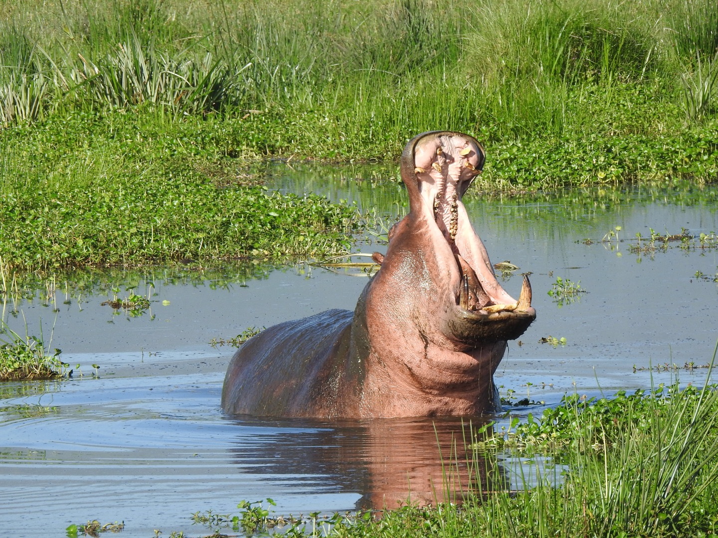
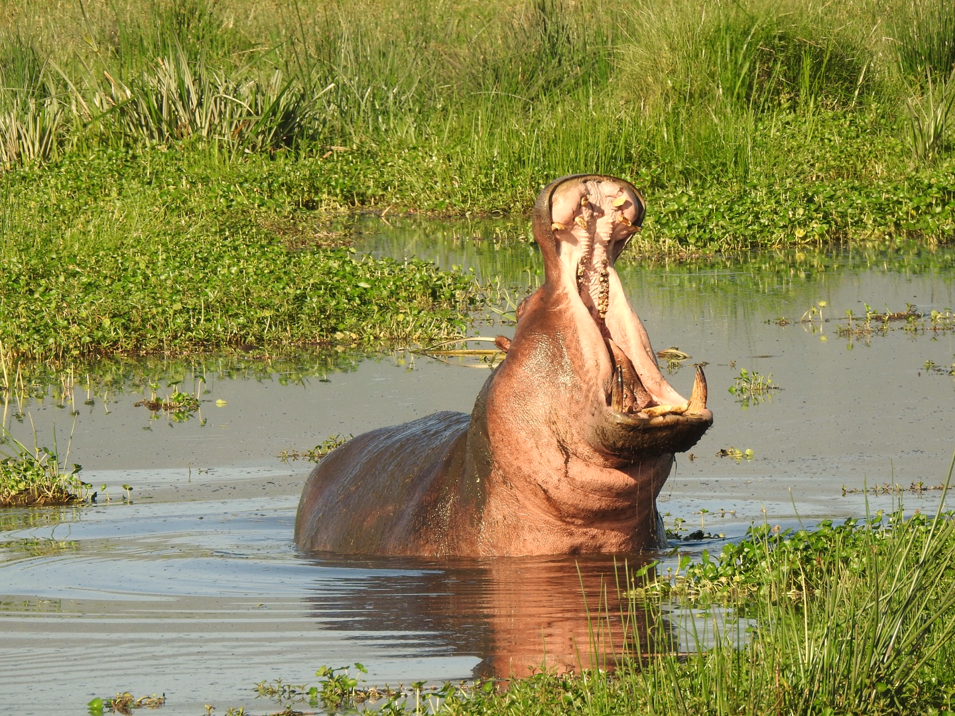
Regularizing CNNs: Data Augmentation
Hippo
Hippo?
Hippo?
Hippo?
Horizontal
Flip
Color
Jitter
Image Cropping
Slide credit: D Fouhey & J Johnson

Slide 12
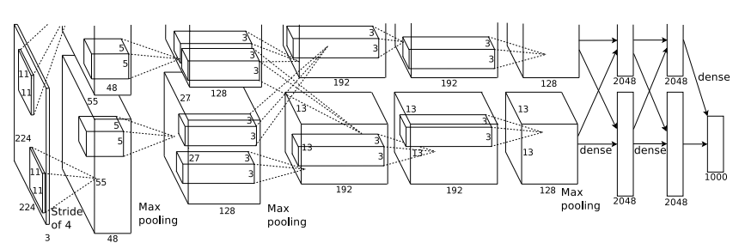
Regularizing CNNs: Data Augmentation
Apply random transformations to input images during training
Artificially “inflate” the size of your dataset
Hippo
Hippo
Training Image
Augmented images
Slide credit: D Fouhey & J Johnson

Slide 13
Training Convolutional Networks
Download big datasets
Design CNN architecture
Initialize Weights
For t = 1 to T:
Form minibatch
Compute loss + gradient
Update Weights
Apply trained model to task
If the model is big, won’t we overfit?
Slide credit: D Fouhey & J Johnson

Slide 14
Training Convolutional Networks
What if we can’t find one?
Download big datasets
Design CNN architecture
Initialize Weights
For t = 1 to T:
Form minibatch
Compute loss + gradient
Update Weights
Apply trained model to task
Slide credit: D Fouhey & J Johnson

Slide 15
Transfer Learning: Feature Extraction
1. Train on ImageNet
FC-1000
FC-4096
FC-4096
MaxPool
Conv-512
Conv-512
MaxPool
Conv-512
Conv-512
MaxPool
Conv-256
Conv-256
MaxPool
Conv-128
Conv-128
MaxPool
Conv-64
Conv-64
Image
Donahue et al, “DeCAF: A Deep Convolutional Activation Feature for Generic Visual Recognition”, ICML 2014
Slide credit: D Fouhey & J Johnson

Slide 16
Transfer Learning: Feature Extraction
1. Train on ImageNet
2. CNN as feature extractor
FC-1000
Remove last layer
Use your small dataset to train a linear classifier on top of pretrained CNN features
FC-4096
FC-4096
FC-4096
FC-4096
MaxPool
MaxPool
Conv-512
Conv-512
Conv-512
Conv-512
MaxPool
MaxPool
Conv-512
Conv-512
Conv-512
Conv-512
Freeze these
MaxPool
MaxPool
Conv-256
Conv-256
Conv-256
Conv-256
MaxPool
MaxPool
Conv-128
Conv-128
Conv-128
Conv-128
MaxPool
MaxPool
Conv-64
Conv-64
Conv-64
Conv-64
Image
Image
Donahue et al, “DeCAF: A Deep Convolutional Activation Feature for Generic Visual Recognition”, ICML 2014
Slide credit: D Fouhey & J Johnson

Slide 17
Transfer Learning: Fine-Tuning
1. Train on ImageNet
2. CNN as feature extractor
3. Bigger dataset: Fine-Tuning
Reinitialize last layer and continue training whole network on your dataset
FC-1000
Remove last layer
FC
FC-4096
FC-4096
FC-4096
FC-4096
FC-4096
FC-4096
MaxPool
MaxPool
MaxPool
Conv-512
Conv-512
Conv-512
Conv-512
Conv-512
Conv-512
MaxPool
MaxPool
MaxPool
Conv-512
Conv-512
Conv-512
Conv-512
Conv-512
Freeze these
Conv-512
MaxPool
MaxPool
MaxPool
Conv-256
Conv-256
Conv-256
Conv-256
Conv-256
Conv-256
MaxPool
MaxPool
MaxPool
Conv-128
Conv-128
Conv-128
Conv-128
Conv-128
Conv-128
MaxPool
MaxPool
MaxPool
Conv-64
Conv-64
Conv-64
Conv-64
Conv-64
Conv-64
Image
Image
Image
Slide credit: D Fouhey & J Johnson

Slide 18
Transfer Learning: Fine-Tuning
1. Train on ImageNet
2. CNN as feature extractor
3. Bigger dataset: Fine-Tuning
Reinitialize last layer and continue training whole network on your dataset
FC-1000
Remove last layer
FC
FC-4096
FC-4096
FC-4096
FC-4096
FC-4096
FC-4096
MaxPool
MaxPool
MaxPool
Conv-512
Conv-512
Conv-512
Conv-512
Conv-512
Conv-512
MaxPool
MaxPool
MaxPool
Some tricks:
Train with feature extraction first before fine-tuning
Lower the learning rate: use ~1/10 of LR used in original training
Sometimes freeze lower layers to save computation
Conv-512
Conv-512
Conv-512
Conv-512
Conv-512
Freeze these
Conv-512
MaxPool
MaxPool
MaxPool
Conv-256
Conv-256
Conv-256
Conv-256
Conv-256
Conv-256
MaxPool
MaxPool
MaxPool
Conv-128
Conv-128
Conv-128
Conv-128
Conv-128
Conv-128
MaxPool
MaxPool
MaxPool
Conv-64
Conv-64
Conv-64
Conv-64
Conv-64
Conv-64
Image
Image
Image
Slide credit: D Fouhey & J Johnson

Slide 19

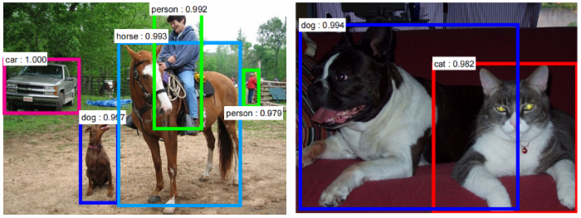
Today’s Class: Object Detection
Image classification
Object detection
Slide credit: S. Lazebnik
Image source

Slide 20
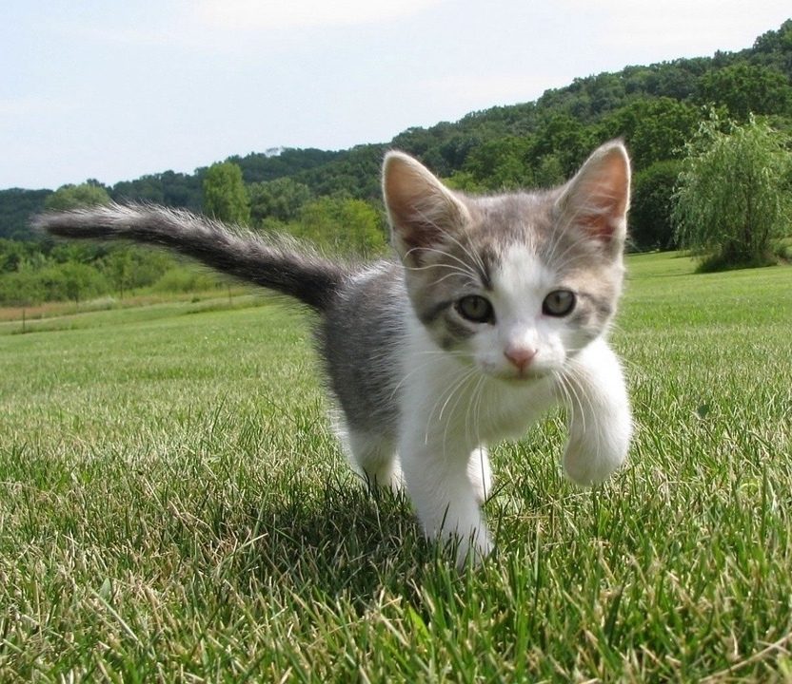
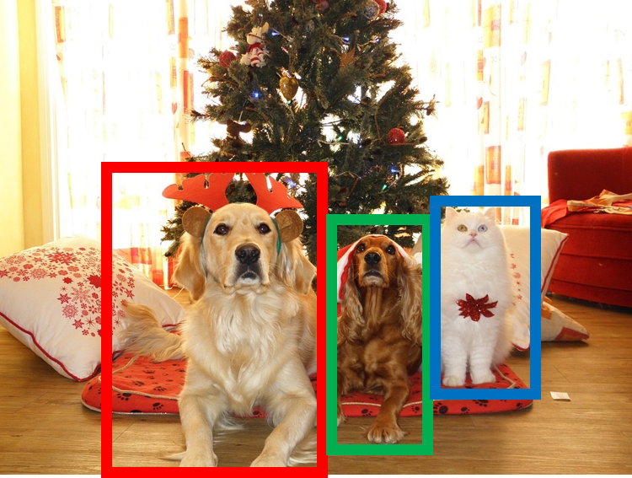
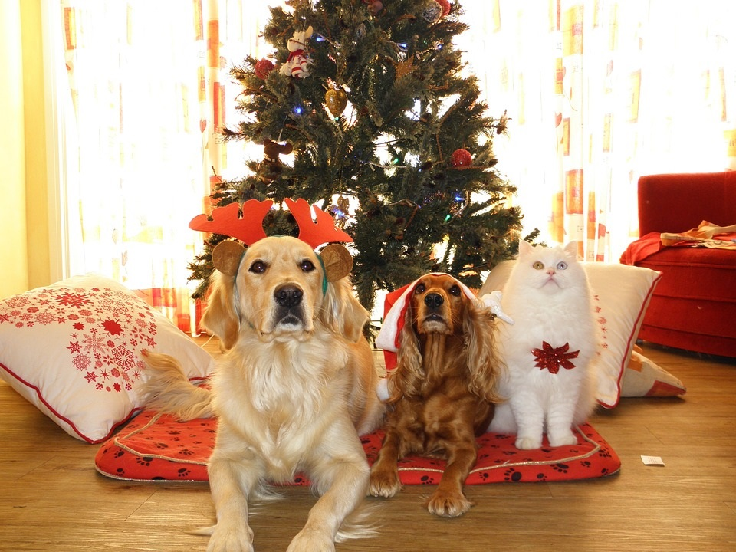
Computer Vision Tasks
Classification
Object Detection
Instance Segmentation
Semantic Segmentation
CAT
DOG, DOG, CAT
DOG, DOG, CAT
GRASS, CAT, TREE, SKY
No spatial extent
Multiple Objects
No objects, just pixels
This image is CC0 public domain
Slide adapted from: D Fouhey & J Johnson

Slide 21
Object Detection: Task Definition
Input: Single RGB Image
Output: A set of detected objects;
For each object predict:
Category label (from fixed, known set of categories)
Bounding box (four numbers: x, y, width, height)
what
where
Slide credit: D Fouhey & J Johnson

Slide 22
Detecting a Single Object
Vector:
4096
This image is CC0 public domain
Slide credit: D Fouhey & J Johnson

Slide 23
Detecting a Single Object
“What”
Correct label:
Cat
Fully
Connected:
4096 to 1000
Class Scores
Cat: 0.9
Dog: 0.05
Car: 0.01
...
Softmax Loss
Vector:
4096
This image is CC0 public domain
Slide credit: D Fouhey & J Johnson

Slide 24
Detecting a Single Object
“What”
Correct label:
Cat
Fully
Connected:
4096 to 1000
Class Scores
Cat: 0.9
Dog: 0.05
Car: 0.01
...
Softmax Loss
Vector:
4096
This image is CC0 public domain
Fully
Connected:
4096 to 4
Treat localization as a regression problem!
Box Coordinates
(x, y, w, h)
L2 Loss
“Where”
Correct box:
(x’, y’, w’, h’)
Slide credit: D Fouhey & J Johnson

Slide 25
Detecting a Single Object
“What”
Correct label:
Cat
Fully
Connected:
4096 to 1000
Class Scores
Cat: 0.9
Dog: 0.05
Car: 0.01
...
Softmax Loss
Weighted Sum
Loss
Vector:
4096
This image is CC0 public domain
Fully
Connected:
4096 to 4
Treat localization as a regression problem!
Box Coordinates
(x, y, w, h)
L2 Loss
“Where”
Correct box:
(x’, y’, w’, h’)
Slide credit: D Fouhey & J Johnson

Slide 26
Detecting a Single Object
“What”
Correct label:
Cat
Fully
Connected:
4096 to 1000
Class Scores
Cat: 0.9
Dog: 0.05
Car: 0.01
...
Softmax Loss
Multitask Loss
Weighted Sum
Loss
Vector:
4096
This image is CC0 public domain
Fully
Connected:
4096 to 4
Treat localization as a regression problem!
Box Coordinates
(x, y, w, h)
L2 Loss
“Where”
Correct box:
(x’, y’, w’, h’)
Slide credit: D Fouhey & J Johnson

Slide 27
Detecting a Single Object
“What”
Correct label:
Cat
Fully
Connected:
4096 to 1000
Class Scores
Cat: 0.9
Dog: 0.05
Car: 0.01
...
Often pretrained on ImageNet
(Transfer learning)
Softmax Loss
Multitask Loss
Weighted Sum
Loss
Vector:
4096
This image is CC0 public domain
Fully
Connected:
4096 to 4
Treat localization as a regression problem!
Box Coordinates
(x, y, w, h)
L2 Loss
“Where”
Correct box:
(x’, y’, w’, h’)
Slide credit: D Fouhey & J Johnson

Slide 28
Detecting a Single Object
“What”
Correct label:
Cat
Fully
Connected:
4096 to 1000
Class Scores
Cat: 0.9
Dog: 0.05
Car: 0.01
...
Often pretrained on ImageNet
(Transfer learning)
Softmax Loss
Multitask Loss
Weighted Sum
Loss
Vector:
4096
This image is CC0 public domain
Fully
Connected:
4096 to 4
Treat localization as a regression problem!
Box Coordinates
(x, y, w, h)
L2 Loss
Problem: Images can have more than one object!
“Where”
Correct box:
(x’, y’, w’, h’)
Slide credit: D Fouhey & J Johnson

Slide 29
Object Detection: Challenges
Multiple outputs: Need to output variable numbers of objects per image
Multiple types of output: Need to predict ”what” (category label) as well as “where” (bounding box)
Large images: Classification works at 224x224; need higher resolution for detection, often ~800x600
Slide credit: D Fouhey & J Johnson

Slide 30

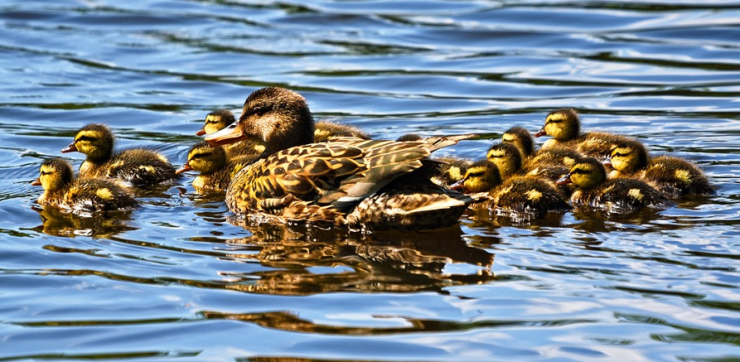
Detecting Multiple Objects
Need different numbers of outputs per image
CAT: (x, y, w, h)
4 numbers
DOG: (x, y, w, h)
DOG: (x, y, w, h)
CAT: (x, y, w, h)
16 numbers
DUCK: (x, y, w, h)
DUCK: (x, y, w, h)
….
Many numbers!
Duck image is free to use under the Pixabay license
Slide credit: D Fouhey & J Johnson

Slide 31
Multiple Objects: Sliding Window
Apply a CNN to many different crops of the image, CNN classifies each crop as object or background
Dog? NO
Cat? NO
Background? YES
Slide credit: D Fouhey & J Johnson

Slide 32
Multiple Objects: Sliding Window
Apply a CNN to many different crops of the image, CNN classifies each crop as object or background
Dog? YES
Cat? NO
Background? NO
Slide credit: D Fouhey & J Johnson

Slide 33
Multiple Objects: Sliding Window
Apply a CNN to many different crops of the image, CNN classifies each crop as object or background
Dog? YES
Cat? NO
Background? NO
Slide credit: D Fouhey & J Johnson

Slide 34
Multiple Objects: Sliding Window
Apply a CNN to many different crops of the image, CNN classifies each crop as object or background
Dog? NO
Cat? YES
Background? NO
Slide credit: D Fouhey & J Johnson

Slide 35
Multiple Objects: Sliding Window
Apply a CNN to many different crops of the image, CNN classifies each crop as object or background
Question: How many possible boxes are there in an image of size H x W?
Slide credit: D Fouhey & J Johnson

Slide 36
Multiple Objects: Sliding Window
Apply a CNN to many different crops of the image, CNN classifies each crop as object or background
Question: How many possible boxes are there in an image of size H x W?
Consider a box of size h x w:
Possible x positions: W – w + 1
Possible y positions: H – h + 1
Possible positions:
(W – w + 1) * (H – h + 1)
Slide credit: D Fouhey & J Johnson

Slide 37
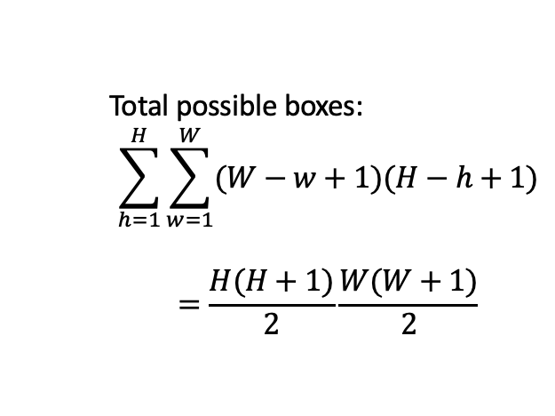
Multiple Objects: Sliding Window
Apply a CNN to many different crops of the image, CNN classifies each crop as object or background
Question: How many possible boxes are there in an image of size H x W?
Consider a box of size h x w:
Possible x positions: W – w + 1
Possible y positions: H – h + 1
Possible positions:
(W – w + 1) * (H – h + 1)
Total possible boxes:
$$\sum_{h=1}^{H}{\sum_{w=1}^{W}{(W−w+1)(H−h+1)}}$$
$$=\frac{H(H+1)}{2}\frac{W(W+1)}{2}$$
Slide credit: D Fouhey & J Johnson

Slide 38
Multiple Objects: Sliding Window
Apply a CNN to many different crops of the image, CNN classifies each crop as object or background
800 x 600 image has ~58M boxes! No way we can evaluate them all
Question: How many possible boxes are there in an image of size H x W?
Consider a box of size h x w:
Possible x positions: W – w + 1
Possible y positions: H – h + 1
Possible positions:
(W – w + 1) * (H – h + 1)
Total possible boxes:
$$\sum_{h=1}^{H}{\sum_{w=1}^{W}{(W−w+1)(H−h+1)}}$$
$$=\frac{H(H+1)}{2}\frac{W(W+1)}{2}$$
What if we consider different scales and aspect ratios?
Slide credit: D Fouhey & J Johnson

Slide 39
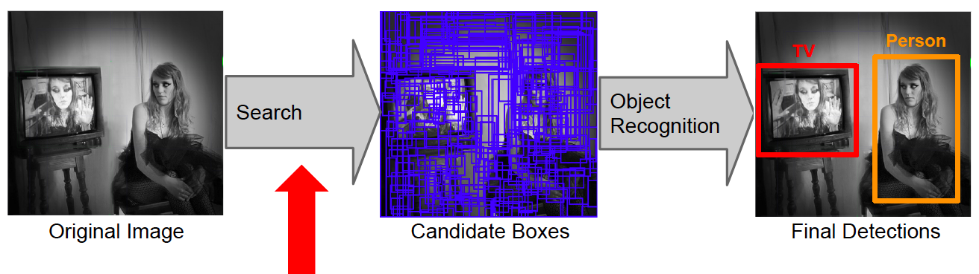
Approaches to detection: Object proposals
Generate and evaluate a few hundred region proposals
Proposal mechanism can take advantage of low-level perceptual organization cues
Proposal mechanism can be category-specific or category-independent, hand-crafted or trained
Classifier can be slower but more powerful
Slide credit: S. Lazebnik

Slide 40
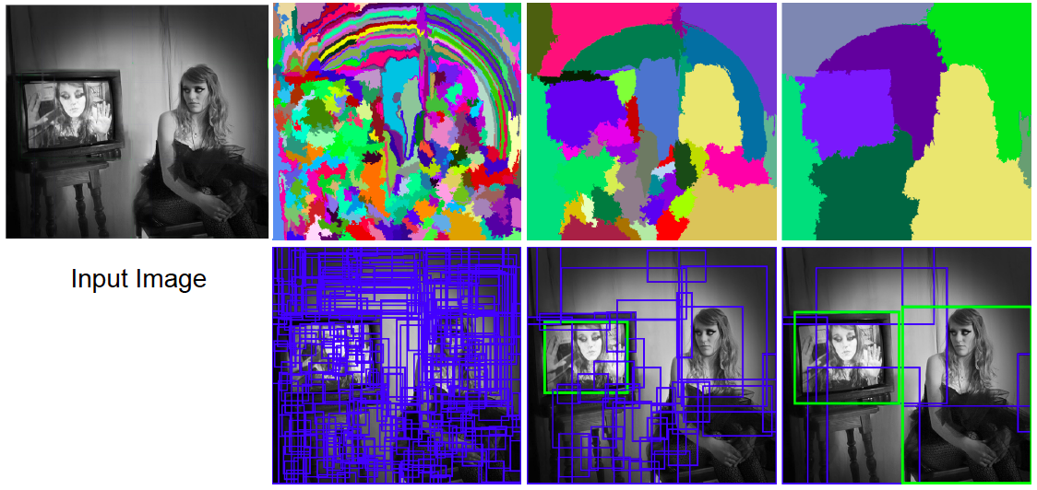
Selective search for detection
Use hierarchical segmentation: start with small superpixels and merge based on diverse cues
J. Uijlings, K. van de Sande, T. Gevers, and A. Smeulders, Selective Search for Object Recognition, IJCV 2013
Slide credit: S. Lazebnik

Slide 41
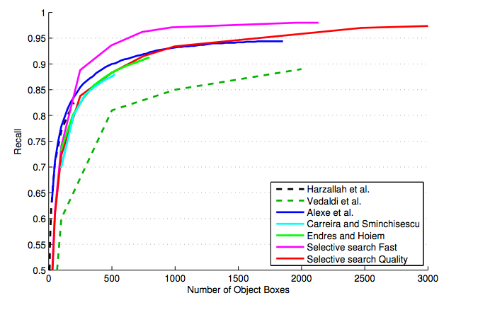
Selective search for detection
Evaluation of region proposals
J. Uijlings, K. van de Sande, T. Gevers, and A. Smeulders, Selective Search for Object Recognition, IJCV 2013
Slide credit: S. Lazebnik

Slide 42
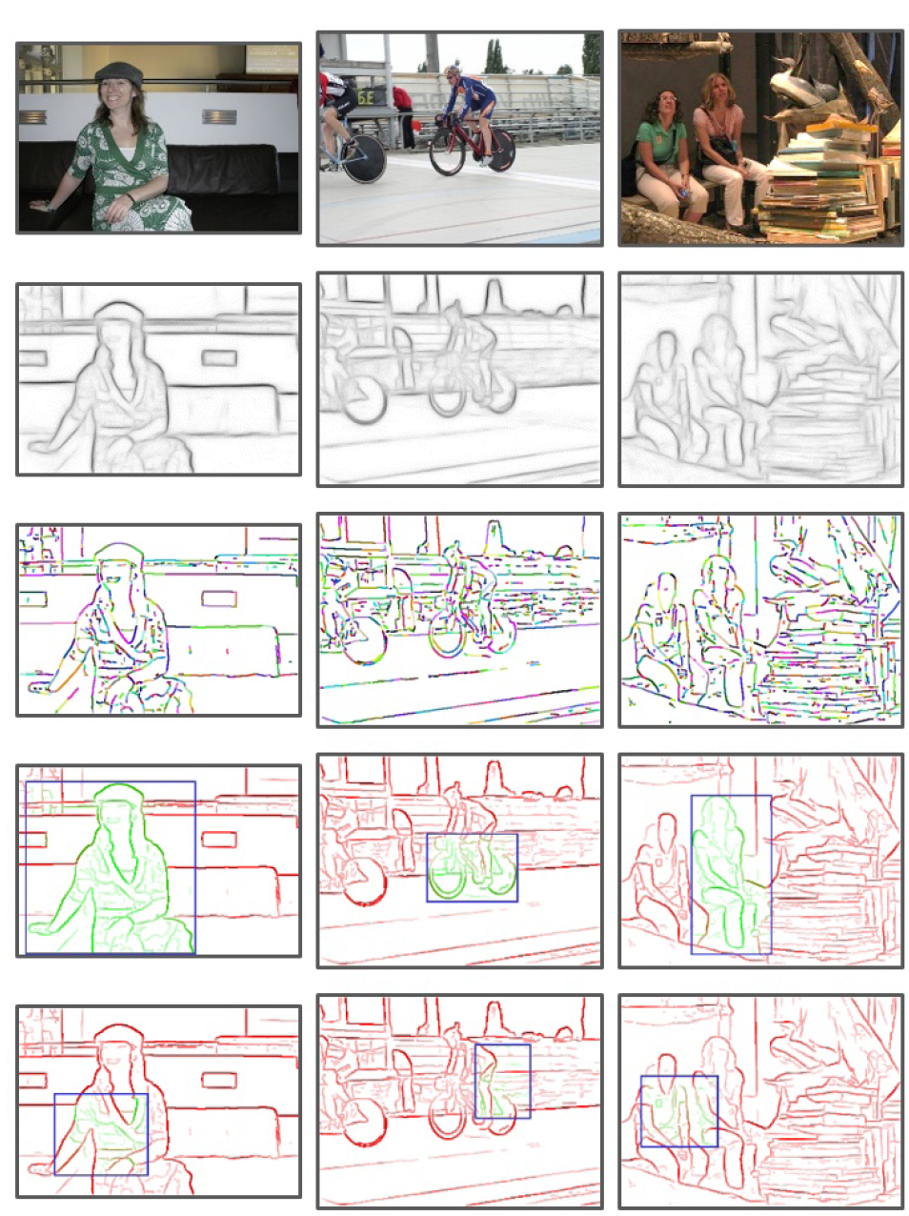
Another proposal method: EdgeBoxes
Box score: number of edges in the box minus number of edges that overlap the box boundary
Uses a trained edge detector
Uses efficient data structures (incl. integral images) for fast evaluation
Gets 75% recall with 800 boxes (vs. 1400 for Selective Search), is 40 times faster
C. Zitnick and P. Dollar, Edge Boxes: Locating Object Proposals from Edges, ECCV 2014
Slide credit: S. Lazebnik

Slide 43
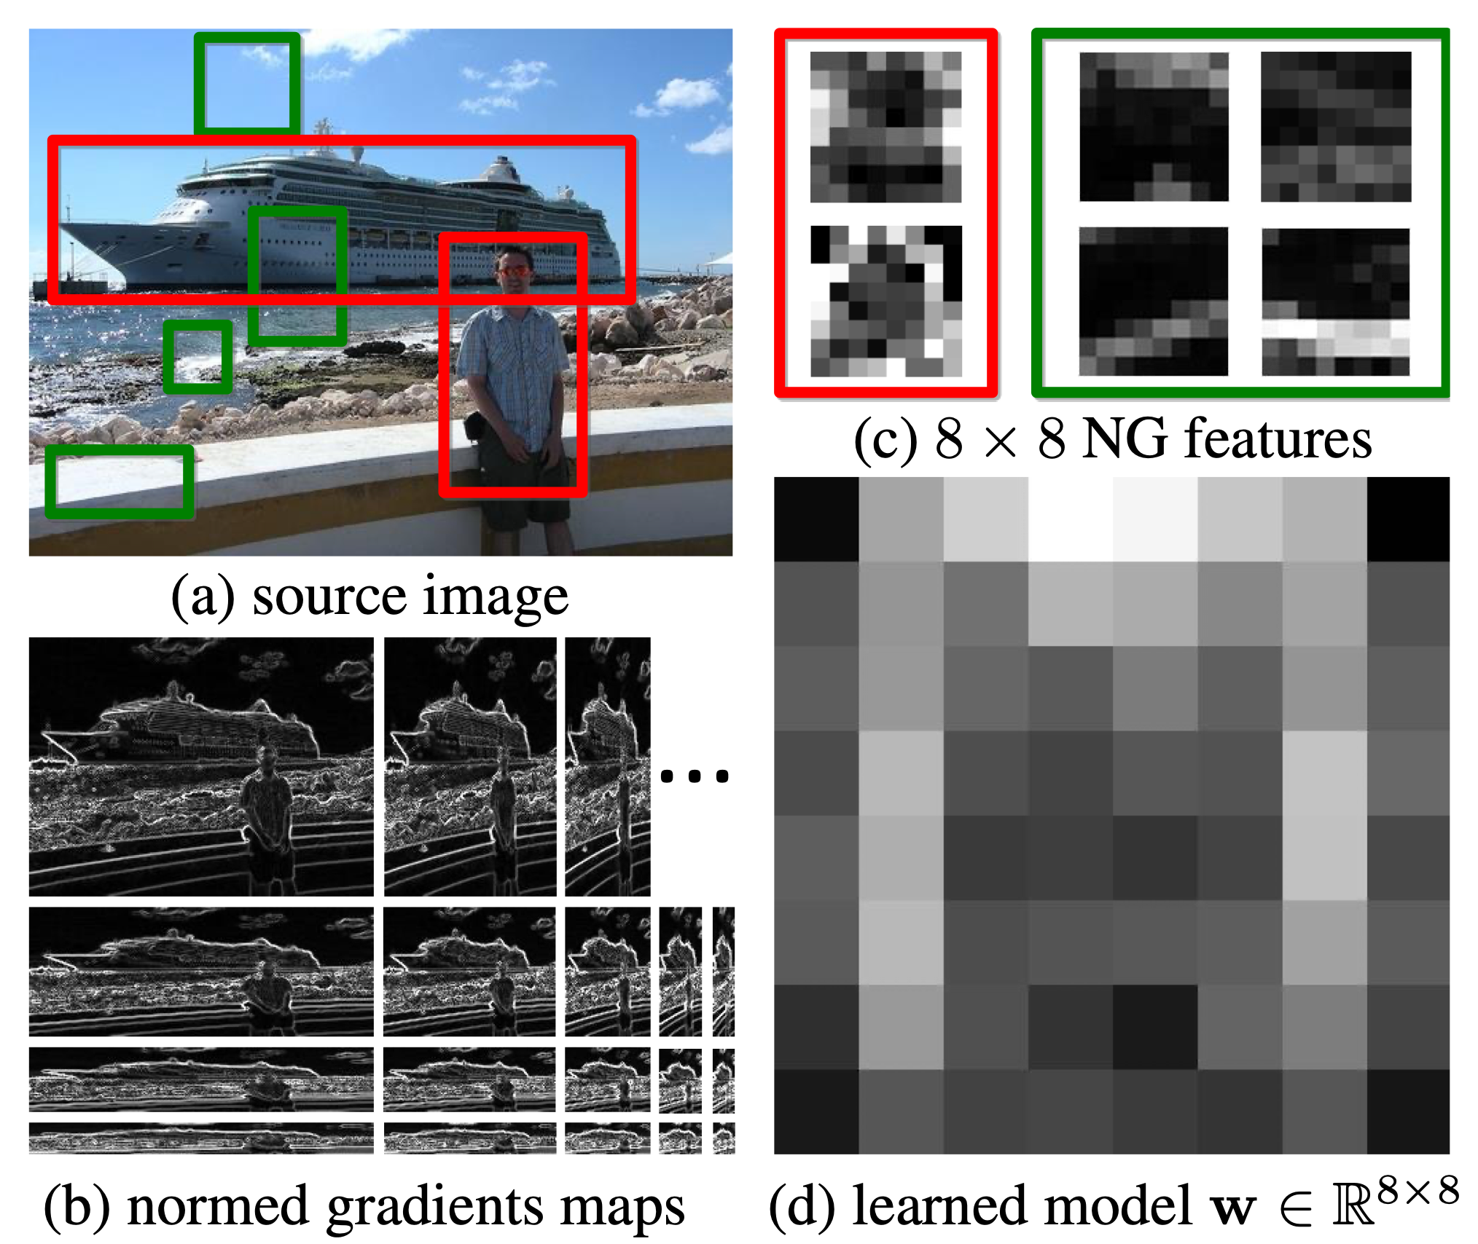
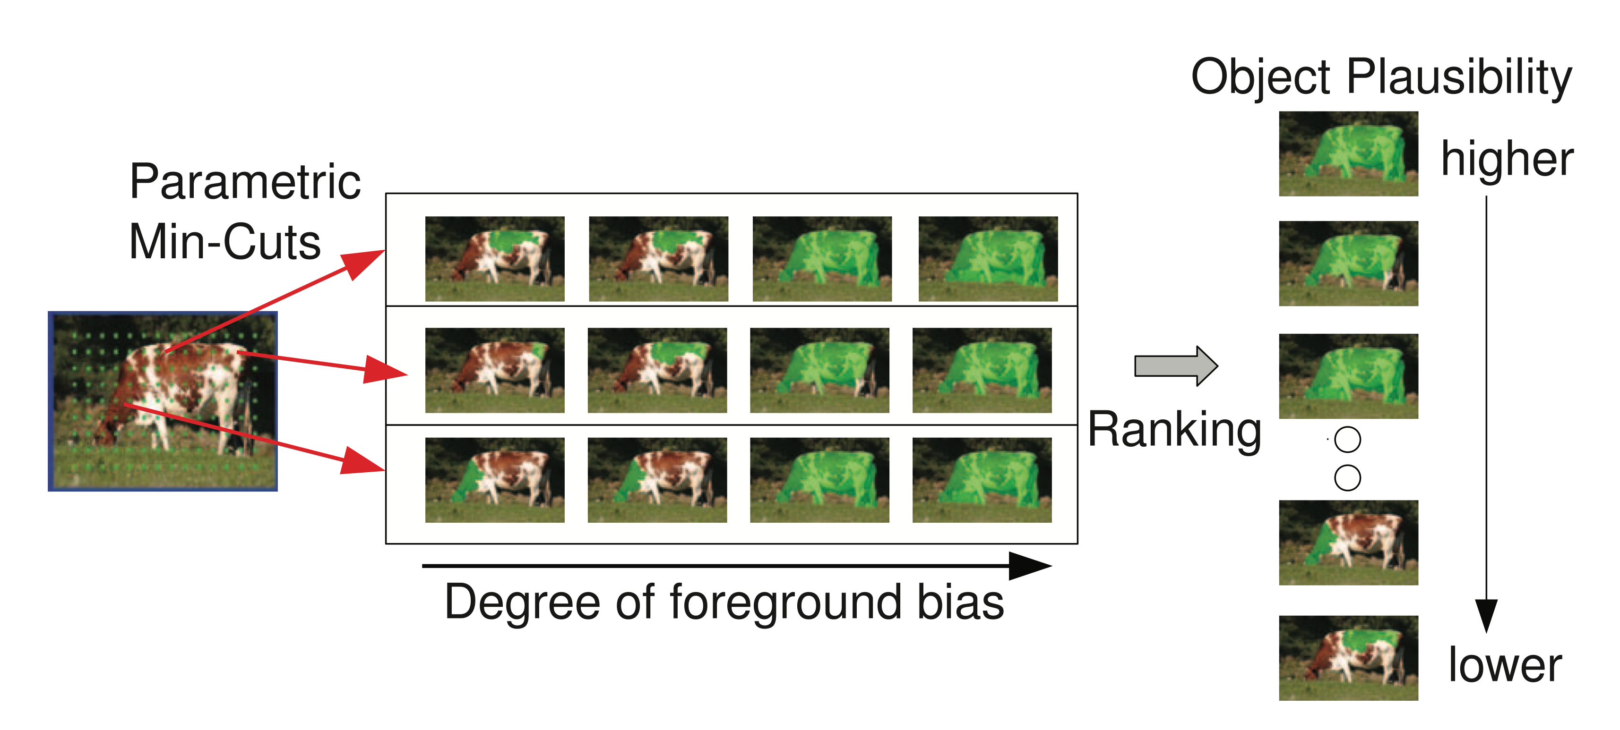
Other Object Proposal Methods
[Cheng et al., CVPR 2014]
[Carreira and Sminchisescu. TPAMI 2012]

Slide 44
Detection strategies: Summary
Before ~2010, dominated by sliding windows
2010-2013: proposal-driven
Deep learning approaches started as proposal-driven (two-stage), but have evolved back toward sliding windows (single-stage)
Most recent methods are converging with dense prediction
Slide credit: S. Lazebnik

Slide 45
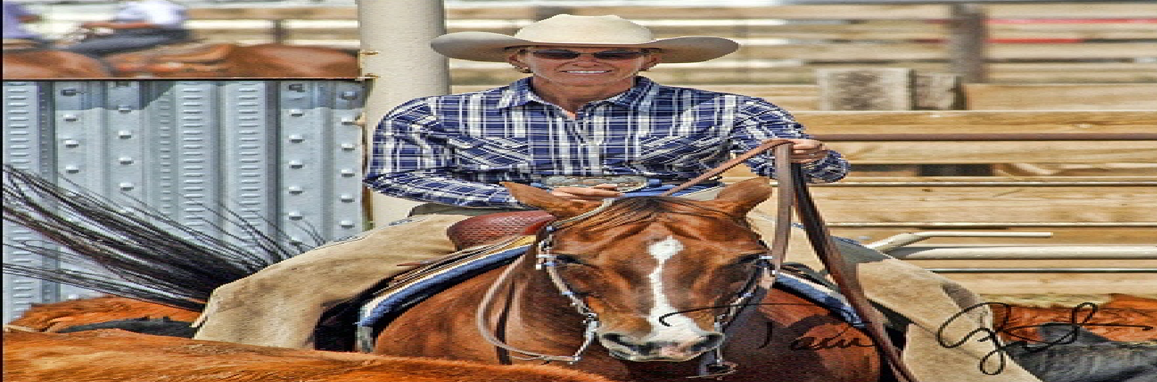
R-CNN: Region-Based CNN
Input image
Girshick et al, “Rich feature hierarchies for accurate object detection and semantic segmentation”, CVPR 2014.
Figure copyright Ross Girshick, 2015; source. Reproduced with permission.
Slide credit: D Fouhey & J Johnson

Slide 46
R-CNN: Region-Based CNN
Regions of Interest (RoI) from a proposal method (~2k)
Input image
Girshick et al, “Rich feature hierarchies for accurate object detection and semantic segmentation”, CVPR 2014.
Figure copyright Ross Girshick, 2015; source. Reproduced with permission.
Slide credit: D Fouhey & J Johnson

Slide 47
R-CNN: Region-Based CNN
Warped image regions (224x224)
Regions of Interest (RoI) from a proposal method (~2k)
Input image
Girshick et al, “Rich feature hierarchies for accurate object detection and semantic segmentation”, CVPR 2014.
Figure copyright Ross Girshick, 2015; source. Reproduced with permission.
Slide credit: D Fouhey & J Johnson

Slide 48
R-CNN: Region-Based CNN
ConvNet
ConvNet
Forward each region through ConvNet
ConvNet
Warped image regions (224x224)
Regions of Interest (RoI) from a proposal method (~2k)
Input image
Girshick et al, “Rich feature hierarchies for accurate object detection and semantic segmentation”, CVPR 2014.
Figure copyright Ross Girshick, 2015; source. Reproduced with permission.
Slide credit: D Fouhey & J Johnson

Slide 49
R-CNN: Region-Based CNN
Classify each region
Class
Class
ConvNet
Class
ConvNet
Forward each region through ConvNet
ConvNet
Warped image regions (224x224)
Regions of Interest (RoI) from a proposal method (~2k)
Input image
Girshick et al, “Rich feature hierarchies for accurate object detection and semantic segmentation”, CVPR 2014.
Figure copyright Ross Girshick, 2015; source. Reproduced with permission.
Slide credit: D Fouhey & J Johnson

Slide 50
R-CNN: Region-Based CNN
Classify each region
Bounding box regression:
Predict “transform” to correct the RoI: 4 numbers (t_{x}, t_{y}, t_{h}, t_{w})
Bbox
Class
Bbox
Class
ConvNet
Bbox
Class
ConvNet
Forward each region through ConvNet
ConvNet
Warped image regions (224x224)
Regions of Interest (RoI) from a proposal method (~2k)
Input image
Girshick et al, “Rich feature hierarchies for accurate object detection and semantic segmentation”, CVPR 2014.
Figure copyright Ross Girshick, 2015; source. Reproduced with permission.
Slide credit: D Fouhey & J Johnson

Slide 51
R-CNN: Region-Based CNN
Classify each region
Bounding box regression:
Predict “transform” to correct the RoI: 4 numbers (t_{x}, t_{y}, t_{h}, t_{w})
Bbox
Class
Bbox
Class
ConvNet
Bbox
Class
ConvNet
Forward each region through ConvNet
Region proposal: (p_{x}, p_{y}, p_{h}, p_{w})
Transform: (t_{x}, t_{y}, t_{h}, t_{w})
Output box: (b_{x}, b_{y}, b_{h}, b_{w})
Translate relative to box size:
b_{x} = p_{x} + p_{w}t_{x} b_{y} = p_{y} + p_{h}t_{y}
Log-space scale transform:
b_{w} = p_{w}exp(t_{w}) b_{h} = p_{h}exp(t_{h})
ConvNet
Warped image regions (224x224)
Regions of Interest (RoI) from a proposal method (~2k)
Input image
Girshick et al, “Rich feature hierarchies for accurate object detection and semantic segmentation”, CVPR 2014.
Figure copyright Ross Girshick, 2015; source. Reproduced with permission.
Slide credit: D Fouhey & J Johnson

Slide 52
R-CNN: Test-time
Input: Single RGB Image
Run region proposal method to compute ~2000 region proposals
Resize each region to 224x224 and run independently through CNN to predict class scores and bbox transform
Use scores to select a subset of region proposals to output (Many choices here: threshold on background, or per-category? Or take top K proposals per image?)
Compare with ground-truth boxes
Bbox
Class
Bbox
Class
ConvNet
Bbox
Class
ConvNet
ConvNet
Input image
Girshick et al, “Rich feature hierarchies for accurate object detection and semantic segmentation”, CVPR 2014.
Figure copyright Ross Girshick, 2015; source. Reproduced with permission.
Slide credit: D Fouhey & J Johnson

Slide 53
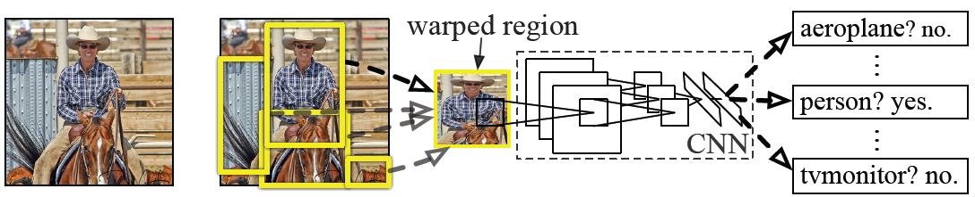
R-CNN Performance
Regions: ~2000 Selective Search proposals
Network: AlexNet pre-trained on ImageNet (1000 classes), fine-tuned on PASCAL (21 classes)
Final detector: warp proposal regions, extract fc7 network activations (4096 dimensions), classify with linear SVM
Bounding box regression to refine box locations
Performance: mAP of 53.7% on PASCAL 2010 (vs. 35.1% for Selective Search and 33.4% for Deformable Part Models)
Slide credit: S. Lazebnik
Notes:
Object detection system overview. Our system (1) takes an input image, (2) extracts around 2000 bottom-up region proposals, (3) computes features for each proposal using a large convolutional neural network (CNN), and then (4) classifies each region using class-specific linear SVMs. R-CNN achieves a mean average precision (mAP) of 53.7% on PASCAL VOC 2010. For comparison, Uijlings et al. (2013) report 35.1% mAP using the same region proposals, but with a spatial pyramid and bag-of-visual-words approach. The popular deformable part models perform at 33.4%.

Slide 54
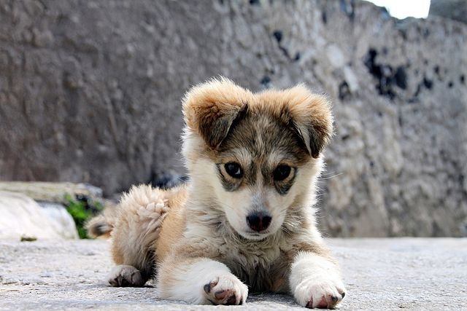
Comparing Boxes: Intersection over Union
How can we compare our prediction to the ground-truth box?
Our Prediction
Ground Truth
Puppy image is licensed under CC-A 2.0 Generic license. Bounding boxes and text added by Justin Johnson.
Slide credit: D Fouhey & J Johnson

Slide 55
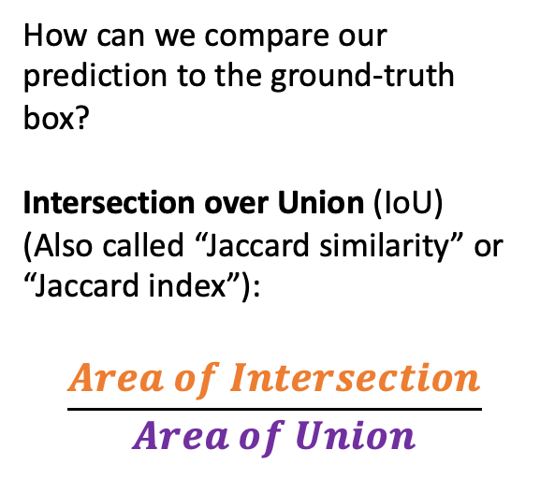
Comparing Boxes: Intersection over Union
How can we compare our prediction to the ground-truth box?
Intersection over Union (IoU)
(Also called “Jaccard similarity” or “Jaccard index”):
$$\frac{Area of Intersection}{Area of Union}$$
Our Prediction
Ground Truth
Puppy image is licensed under CC-A 2.0 Generic license. Bounding boxes and text added by Justin Johnson.
Slide credit: D Fouhey & J Johnson

Slide 56
Comparing Boxes: Intersection over Union
How can we compare our prediction to the ground-truth box?
Intersection over Union (IoU)
(Also called “Jaccard similarity” or “Jaccard index”):
$$\frac{Area of Intersection}{Area of Union}$$
Our Prediction
Ground Truth
Puppy image is licensed under CC-A 2.0 Generic license. Bounding boxes and text added by Justin Johnson.
Slide credit: D Fouhey & J Johnson

Slide 57
Comparing Boxes: Intersection over Union
How can we compare our prediction to the ground-truth box?
Intersection over Union (IoU)
(Also called “Jaccard similarity” or “Jaccard index”):
$$\frac{Area of Intersection}{Area of Union}$$
Our Prediction
Ground Truth
IoU = 0.51
IoU > 0.5 is “decent”,
Puppy image is licensed under CC-A 2.0 Generic license. Bounding boxes and text added by Justin Johnson.
Slide credit: D Fouhey & J Johnson

Slide 58
Comparing Boxes: Intersection over Union
How can we compare our prediction to the ground-truth box?
Intersection over Union (IoU)
(Also called “Jaccard similarity” or “Jaccard index”):
$$\frac{Area of Intersection}{Area of Union}$$
Our Prediction
Ground Truth
IoU = 0.72
IoU > 0.5 is “decent”,
IoU > 0.7 is “pretty good”,
Puppy image is licensed under CC-A 2.0 Generic license. Bounding boxes and text added by Justin Johnson.
Slide credit: D Fouhey & J Johnson

Slide 59
Comparing Boxes: Intersection over Union
How can we compare our prediction to the ground-truth box?
Intersection over Union (IoU)
(Also called “Jaccard similarity” or “Jaccard index”):
$$\frac{Area of Intersection}{Area of Union}$$
Our Prediction
Ground Truth
IoU = 0.91
IoU > 0.5 is “decent”,
IoU > 0.7 is “pretty good”,
IoU > 0.9 is “almost perfect”
Puppy image is licensed under CC-A 2.0 Generic license. Bounding boxes and text added by Justin Johnson.
Slide credit: D Fouhey & J Johnson

Slide 60
Evaluating Detectors
True detection: high intersection over union
Precision: #true detections / #detections
Recall: #true detections / #true positives
Reject everything: no mistakes
1
Ideal!
Summarize by area under curve (avg. precision)
Precision
Accept everything:
Miss nothing
0
1
Recall
Slide Credit: David Fouhey
Slide credit: D Fouhey & J Johnson

Slide 61
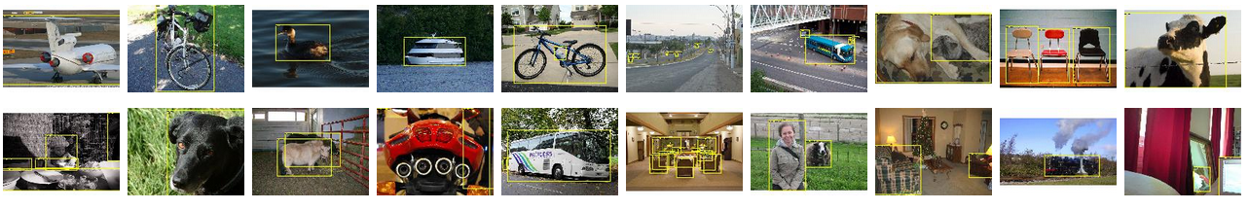
PASCAL VOC Challenge (2005-2012)
20 challenge classes:
Person
Animals: bird, cat, cow, dog, horse, sheep
Vehicles: airplane, bicycle, boat, bus, car, motorbike, train
Indoor: bottle, chair, dining table, potted plant, sofa, tv/monitor
Dataset size (by 2012): 11.5K training/validation images, 27K bounding boxes, 7K segmentations
http://host.robots.ox.ac.uk/pascal/VOC/
Slide credit: S. Lazebnik

Slide 62
Progress on PASCAL detection
PASCAL VOC
Before CNNs
After CNNs
Slide credit: S. Lazebnik

Slide 63
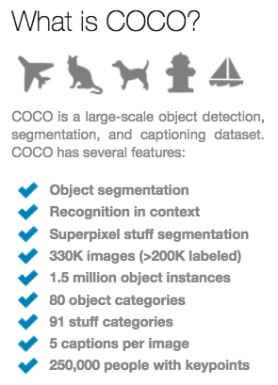
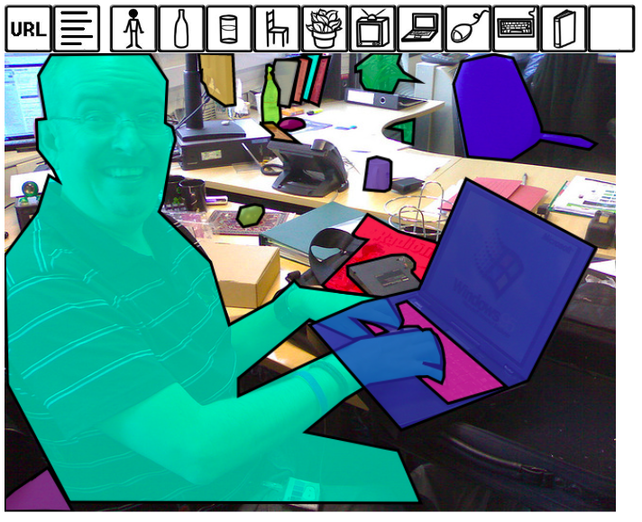
More challenging benchmark: COCO
http://cocodataset.org/#home
Slide credit: S. Lazebnik

Slide 64
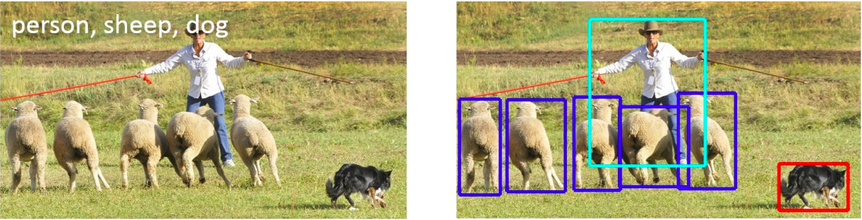
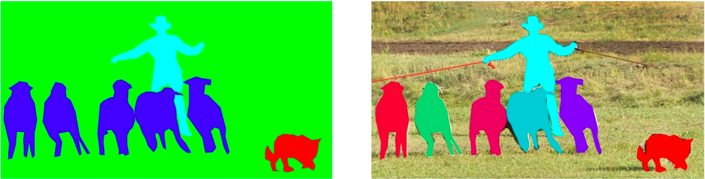
COCO dataset: Tasks
image classification
object detection
semantic segmentation
instance segmentation
Also: keypoint prediction, captioning, question answering…
Slide credit: S. Lazebnik

Slide 65
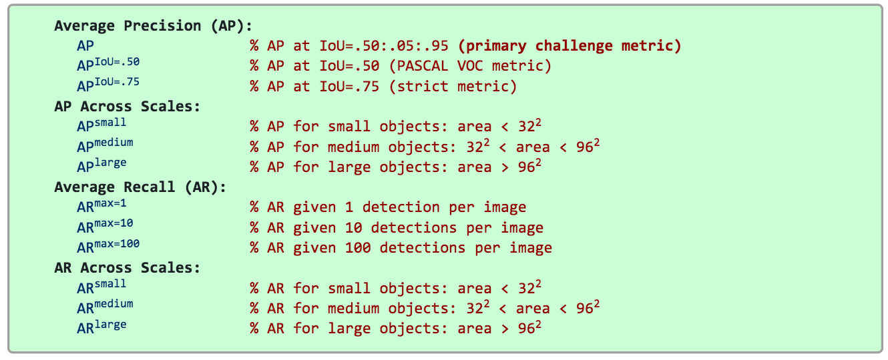
COCO detection metrics
Leaderboard: http://cocodataset.org/#detection-leaderboard
Official COCO challenges no longer include detection
Emphasis has shifted to instance segmentation and dense semantic segmentation
Slide credit: S. Lazebnik

Slide 66
R-CNN: Region-Based CNN
Bbox
Class
Problem: Very slow! Need to do ~2k forward passes for each image!
Bbox
Class
ConvNet
Bbox
Class
ConvNet
ConvNet
Input image
Girshick et al, “Rich feature hierarchies for accurate object detection and semantic segmentation”, CVPR 2014.
Figure copyright Ross Girshick, 2015; source. Reproduced with permission.
Slide credit: D Fouhey & J Johnson

Slide 67
R-CNN pros and cons
Pros
Much more accurate than previous approaches!
Any deep architecture can immediately be “plugged in”
Cons
Not a single end-to-end system
Fine-tune network with softmax classifier (log loss)
Train post-hoc linear SVMs (hinge loss)
Train post-hoc bounding-box regressions (least squares)
Training was slow (84h), took up a lot of storage
2000 CNN passes per image
Inference (detection) was slow (47s / image with VGG16)
Slide credit: S. Lazebnik

Slide 68
R-CNN: Region-Based CNN
Bbox
Class
Problem: Very slow! Need to do ~2k forward passes for each image!
Bbox
Class
ConvNet
Bbox
Class
ConvNet
ConvNet
Solution: Run CNN *before* cropping!
Input image
Girshick et al, “Rich feature hierarchies for accurate object detection and semantic segmentation”, CVPR 2014.
Figure copyright Ross Girshick, 2015; source. Reproduced with permission.
Slide credit: D Fouhey & J Johnson

Slide 69
Fast R-CNN
“Slow” R-CNN
Process each region independently
Input image
Girshick, “Fast R-CNN”, ICCV 2015. Figure copyright Ross Girshick, 2015; source. Reproduced with permission.
Slide credit: D Fouhey & J Johnson

Slide 70
Fast R-CNN
“Slow” R-CNN
Process each region independently
Image features
“Backbone” network: AlexNet, VGG, ResNet, etc
ConvNet
Run whole image
through ConvNet
Input image
Girshick, “Fast R-CNN”, ICCV 2015. Figure copyright Ross Girshick, 2015; source. Reproduced with permission.
Slide credit: D Fouhey & J Johnson

Slide 71
Fast R-CNN
“Slow” R-CNN
Process each region independently
Regions of
Interest (RoIs)
from a proposal
method
Image features
“Backbone” network: AlexNet, VGG, ResNet, etc
ConvNet
Run whole image
through ConvNet
Input image
Girshick, “Fast R-CNN”, ICCV 2015. Figure copyright Ross Girshick, 2015; source. Reproduced with permission.
Slide credit: D Fouhey & J Johnson

Slide 72
Fast R-CNN
“Slow” R-CNN
Process each region independently
Regions of
Interest (RoIs)
from a proposal
method
Crop + Resize features
Image features
“Backbone” network: AlexNet, VGG, ResNet, etc
ConvNet
Run whole image
through ConvNet
Input image
Girshick, “Fast R-CNN”, ICCV 2015. Figure copyright Ross Girshick, 2015; source. Reproduced with permission.
Slide credit: D Fouhey & J Johnson

Slide 73
Fast R-CNN
“Slow” R-CNN
Process each region independently
Regions of
Interest (RoIs)
from a proposal
method
CNN
CNN
CNN
Per-Region Network
Crop + Resize features
Image features
“Backbone” network: AlexNet, VGG, ResNet, etc
ConvNet
Run whole image
through ConvNet
Input image
Girshick, “Fast R-CNN”, ICCV 2015. Figure copyright Ross Girshick, 2015; source. Reproduced with permission.
Slide credit: D Fouhey & J Johnson

Slide 74
Fast R-CNN
Bbox
Bbox
Bbox
Category and box transform per region
“Slow” R-CNN
Process each region independently
Class
Class
Class
Regions of
Interest (RoIs)
from a proposal
method
CNN
CNN
CNN
Per-Region Network
Crop + Resize features
Image features
“Backbone” network: AlexNet, VGG, ResNet, etc
ConvNet
Run whole image
through ConvNet
Input image
Girshick, “Fast R-CNN”, ICCV 2015. Figure copyright Ross Girshick, 2015; source. Reproduced with permission.
Slide credit: D Fouhey & J Johnson

Slide 75
Fast R-CNN
Bbox
Bbox
Bbox
Category and box transform per region
Class
Class
Class
Per-Region network is relatively lightweight
Regions of
Interest (RoIs)
from a proposal
method
CNN
CNN
CNN
Per-Region Network
Crop + Resize features
Image features
“Backbone” network: AlexNet, VGG, ResNet, etc
ConvNet
Run whole image
through ConvNet
Most of the computation happens in backbone network; this saves work for overlapping region proposals
Input image
Girshick, “Fast R-CNN”, ICCV 2015. Figure copyright Ross Girshick, 2015; source. Reproduced with permission.
Slide credit: D Fouhey & J Johnson

Slide 76
Fast R-CNN
Bbox
Bbox
Bbox
Category and box transform per region
Example:
When using AlexNet for detection, five conv layers are used for backbone and two FC layers are used for per-region network
Class
Class
Class
Regions of
Interest (RoIs)
from a proposal
method
CNN
CNN
CNN
Per-Region Network
Crop + Resize features
Image features
“Backbone” network: AlexNet, VGG, ResNet, etc
ConvNet
Run whole image
through ConvNet
Input image
Girshick, “Fast R-CNN”, ICCV 2015. Figure copyright Ross Girshick, 2015; source. Reproduced with permission.
Slide credit: D Fouhey & J Johnson

Slide 77
Fast R-CNN
Bbox
Bbox
Bbox
Category and box transform per region
Example:
For ResNet, last stage is used as per-region network; the rest of the network is used as backbone
Class
Class
Class
Regions of
Interest (RoIs)
from a proposal
method
CNN
CNN
CNN
Per-Region Network
Crop + Resize features
Image features
“Backbone” network: AlexNet, VGG, ResNet, etc
ConvNet
Run whole image
through ConvNet
Input image
Girshick, “Fast R-CNN”, ICCV 2015. Figure copyright Ross Girshick, 2015; source. Reproduced with permission.
Slide credit: D Fouhey & J Johnson

Slide 78
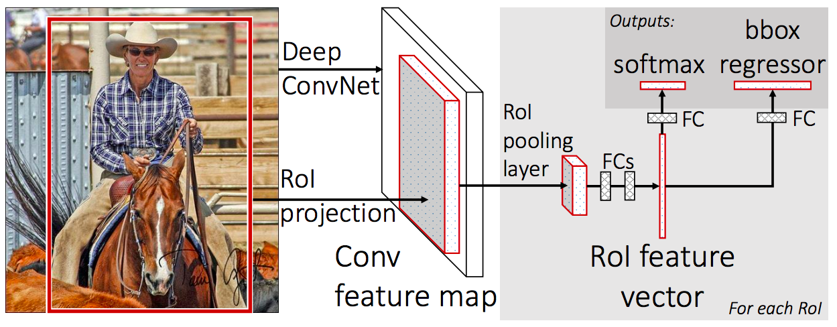
RoIPool and RoIAlign
R. Girshick, Fast R-CNN, ICCV 2015

Slide 79
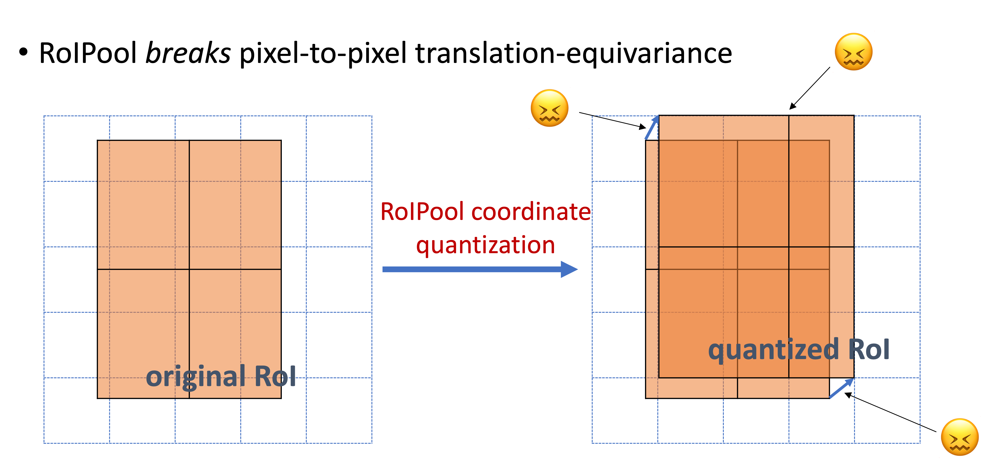
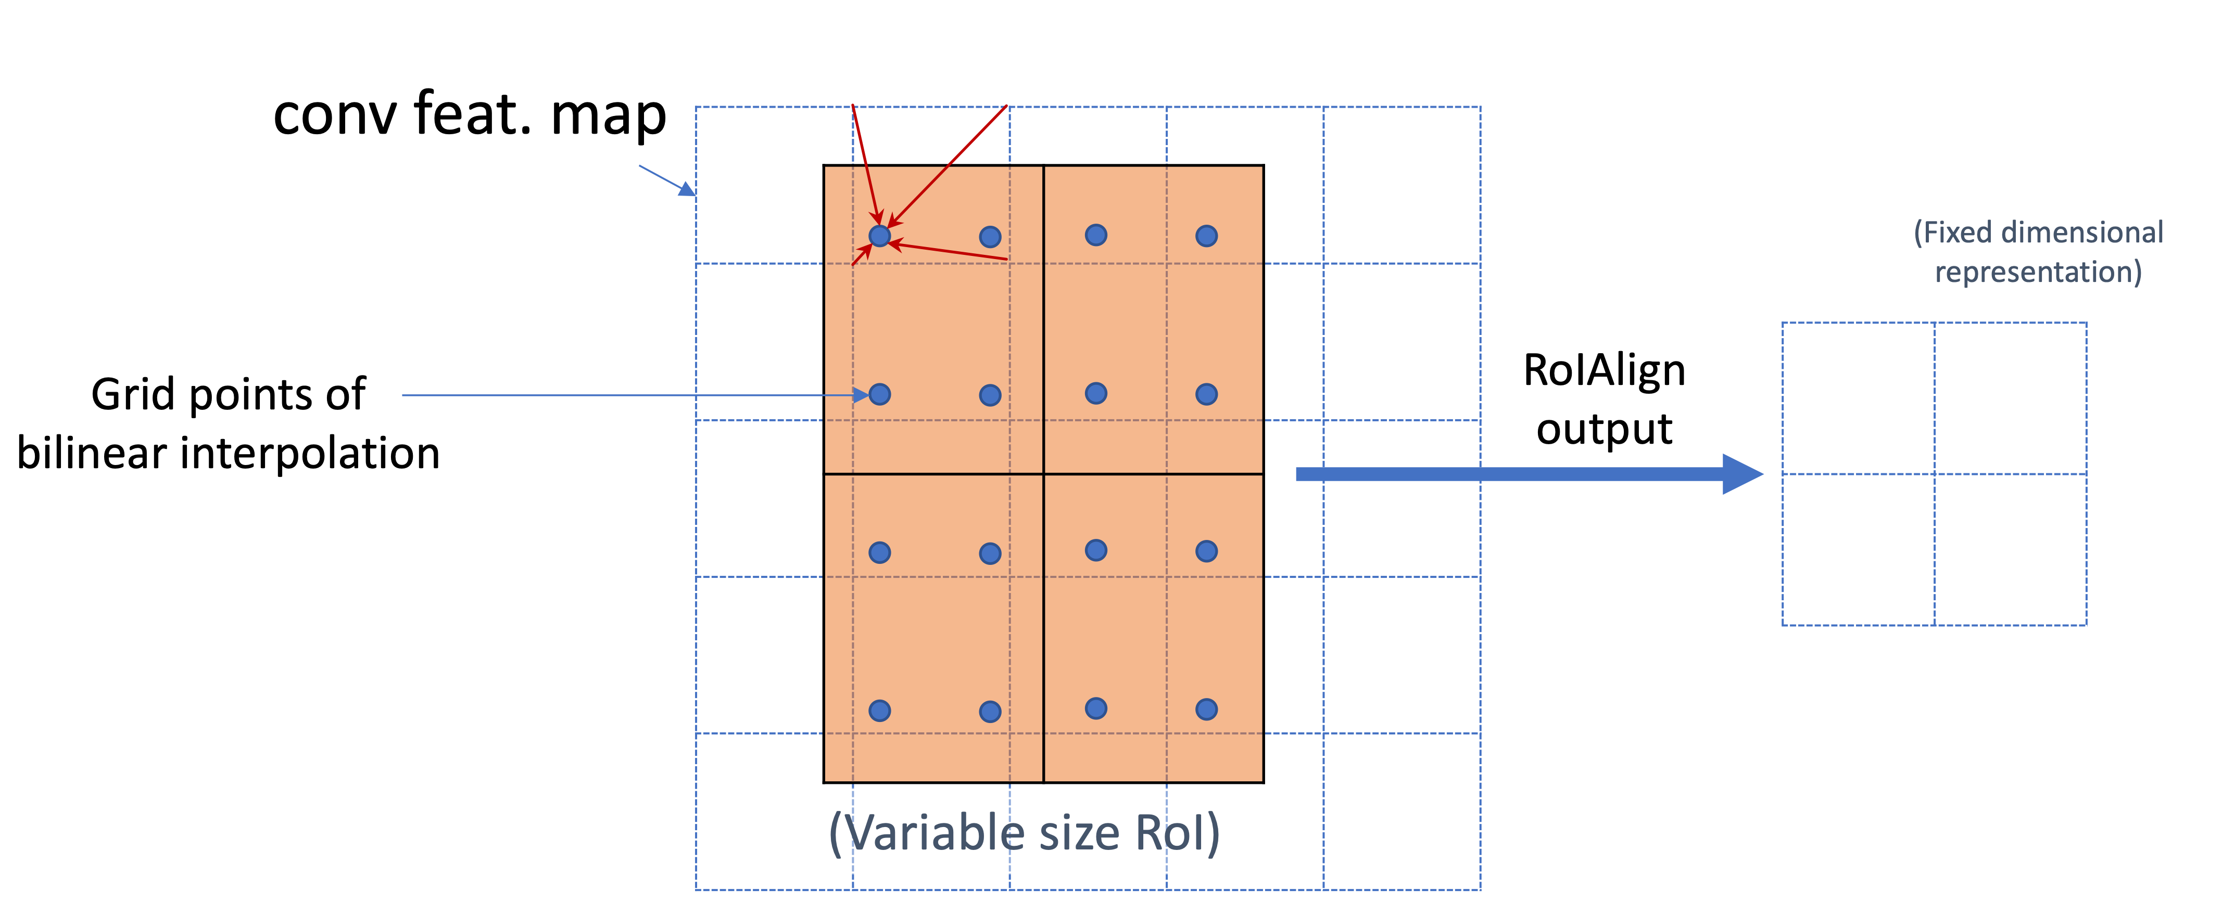
RoIPool and RoIAlign
RoIPool
RoIAlign
[He et al., ICCV 2017]
Diagram credit: Kaiming He

Slide 80
Fast R-CNN results
 | Fast R-CNN | R-CNN
Train time (h) | 9.5 | 84
- Speedup | 8.8x
Test time / image | 0.32s | 47.0s
- Test speedup | 146x
mAP | 66.9% | 66.0%
(vs. 53.7% for AlexNet)
Timings exclude object proposal time, which is equal for all methods.
All methods use VGG16.
Slide credit: S. Lazebnik
Source: R. Girshick, K. He
Notes:
These speed improvements do not sacrifice object detection accuracy. In fact, mean average precision is better than the baseline methods due to our improved training.

Slide 81
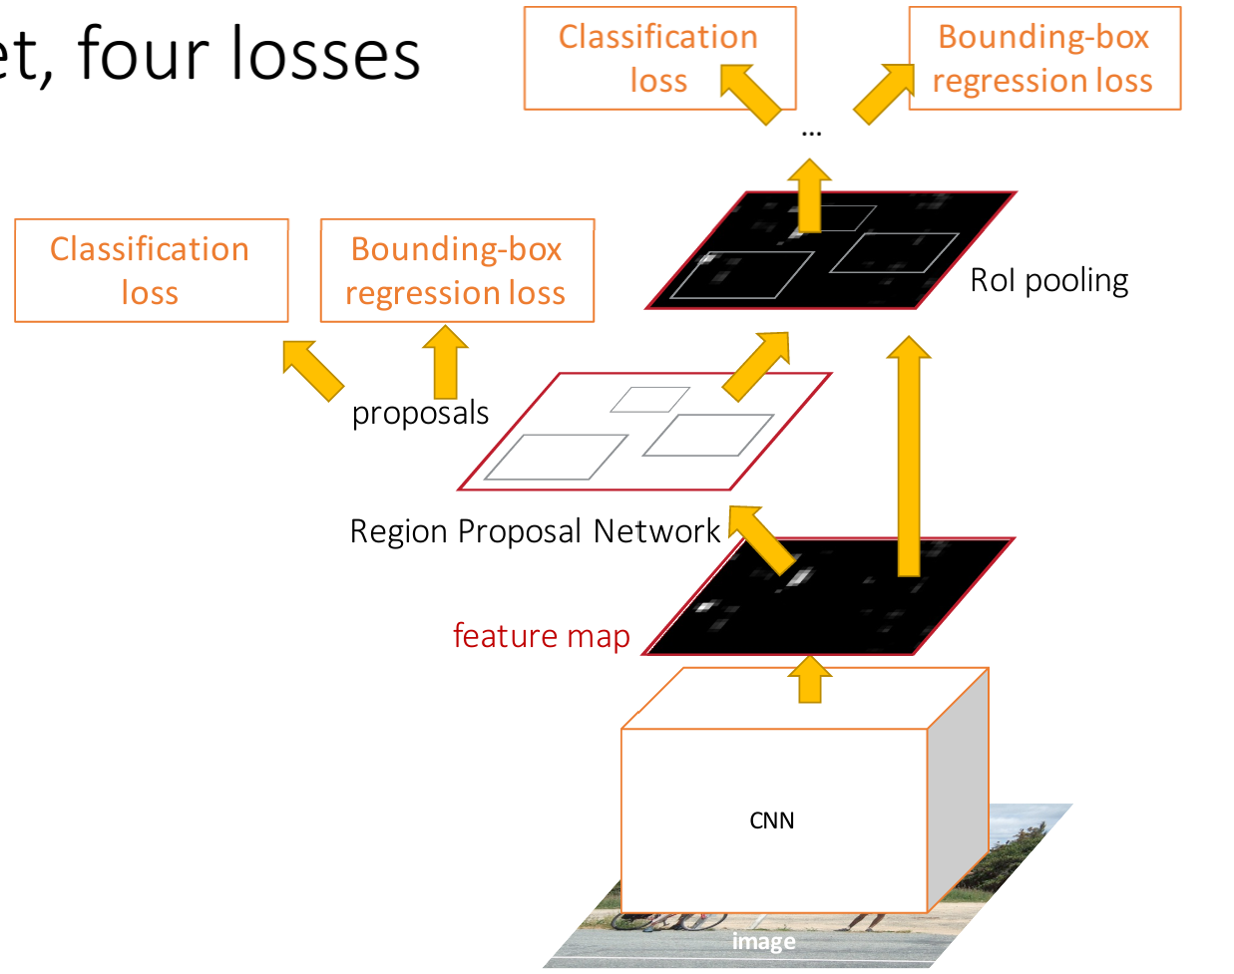
Faster R-CNN: Learnable Region Proposals
Insert Region Proposal Network (RPN) to predict proposals from features
Otherwise same as Fast R-CNN: Crop features for each proposal, classify each one
Ren et al, “Faster R-CNN: Towards Real-Time Object Detection with Region Proposal Networks”, NIPS 2015
Figure copyright 2015, Ross Girshick; reproduced with permission
Slide credit: D Fouhey & J Johnson

Slide 82
Region proposal network (RPN)
Idea: put an “anchor box” of fixed size over each position in the feature map and try to predict whether this box is likely to contain an object
Anchor is an object?
Slide credit: S. Lazebnik
Figure source: J. Johnson

Slide 83
Region proposal network (RPN)
Idea: put an “anchor box” of fixed size over each position in the feature map and try to predict whether this box is likely to contain an object
Anchor is an object?
Slide credit: S. Lazebnik
Figure source: J. Johnson

Slide 84
Region proposal network (RPN)
Idea: put an “anchor box” of fixed size over each position in the feature map and try to predict whether this box is likely to contain an object
Anchor is an object?
Conv
Slide credit: S. Lazebnik
Figure source: J. Johnson

Slide 85
Region proposal network (RPN)
Idea: put an “anchor box” of fixed size over each position in the feature map and try to predict whether this box is likely to contain an object
Introduce anchor boxes at multiple scales and aspect ratios to handle a wider range of object sizes and shapes
Anchor is object?
Anchor is object?
Anchor is object?
Anchor is object?
Conv
Slide credit: S. Lazebnik
Figure source: J. Johnson

Slide 86
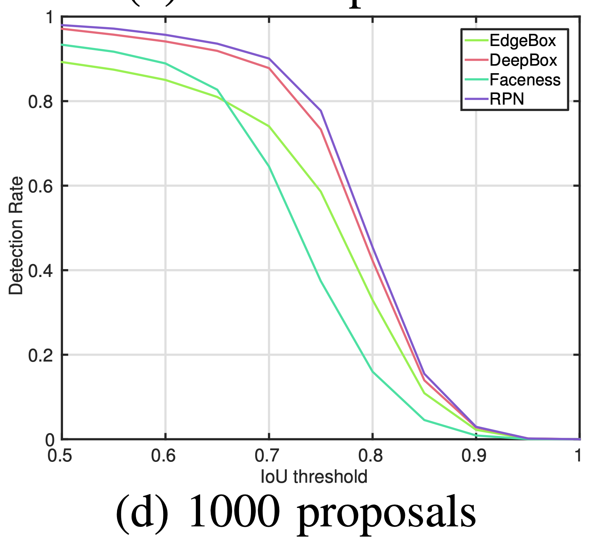
Effectiveness of Learned Region Proposals
[Jiang and Learned-Miller. FG 2017]

Slide 87
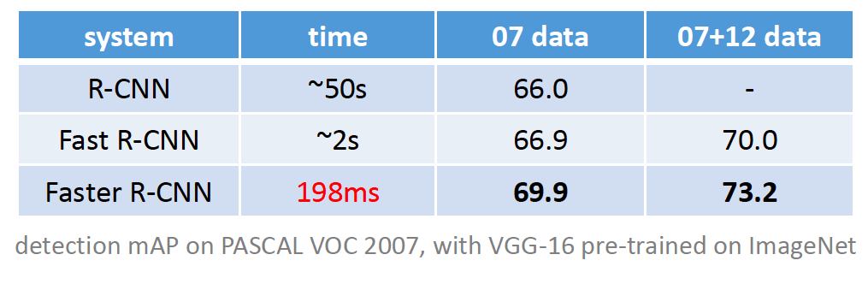
Faster R-CNN results
Slide credit: S. Lazebnik

Slide 88
Object detection progress
Faster R-CNN
Fast R-CNN
Before CNNs
R-CNNv1
After CNNs
Slide credit: S. Lazebnik
Figure source: J. Johnson

Slide 89
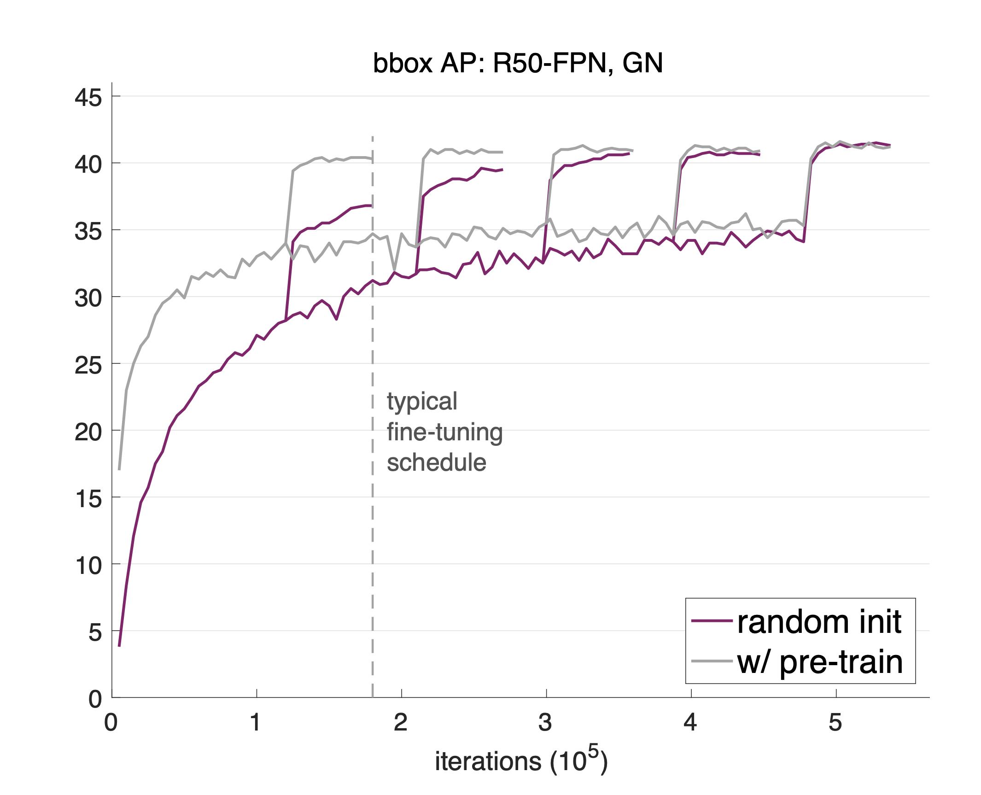
Effectiveness of ImageNet Pre-training
If there are sufficient data for a downstream task, the model trained from random initialization needs more iterations to converge, but converges to a solution that is no worse than the counterpart pre-trained on ImageNet
[He et al., Rethinking ImageNet Pre-training. ICCV 2019]

Slide 90
Next Class
A bit more about Faster R-CNN (two-stage detectors)
One-stage detectors (YOLO, SSD, RetinaNet)
Recent trends

